Slide 1


LECTURE 1
Repeat After Me

Slide 2
GOTO statement
The goto statement can be used to unconditionally jump to a label in the enclosing function.
LABEL: //statements goto LABEL;
LECTURE 1
Repeat after me
LECTURE 1
Repeat After Me

Slide 3
How would we check if a letter is a vowel?
LECTURE 1
Repeat after me
LECTURE 1
Repeat After Me

Slide 4
SWITCH
General Syntax:
If executes the program based on the condition, but is there a better way to do it, based on the values of certain expressions?
Turns out switch is just what you need.
Executes blocks based on the value of certain expressions.
switch(expression) { case constant-expression:
statement; break; case constant-expression:
statement; break;
... }
LECTURE 1
Repeat after me
LECTURE 1
Repeat After Me

Slide 5
You want to iterate the value of a variable from 1 to 5
How can we achieve that?
LECTURE 1
Repeat after me
LECTURE 1
Repeat After Me

Slide 6
int a = 1; a += 1; a ++; a ++; a ++;
This method works fine, but what if we want to check if an increment makes ‘a’ even or odd?
LECTURE 1
Repeat after me
LECTURE 1
Repeat After Me

Slide 7
int a = 1; if (a%2 == 0) //even else //odd a++; if (a%2 == 0) //even else //odd . . . . . . . and so on
LECTURE 1
Repeat after me
LECTURE 1
Repeat After Me

Slide 8
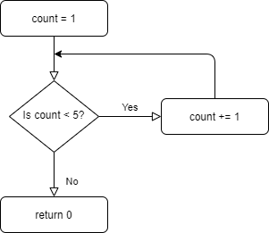
//iterate from 1 to 5 int main() { int count = 1; HERE: if (count < 5) { count += 1; goto HERE; } return 0; }
LECTURE 1
Repeat after me
LECTURE 1
Repeat After Me

Slide 9
Well, if we can loop using goto, why do loop statements exist?
Though goto seems to be a powerful tool we can use in our programs, it is discouraged to use goto as much as you can.
using too many goto statement means that the flow of the program is harder to trace
the code becomes hard to read
LECTURE 1
Repeat after me
LECTURE 1
Repeat After Me

Slide 10
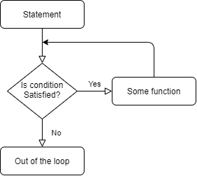
Getting back in the loop
When programming, you generally may come across certain problems that require repetitions.
Every applications uses a loop. For example, a game uses a loop to keep the game running until the user exists the game.
LECTURE 1
Repeat after me
LECTURE 1
Repeat After Me

Slide 11
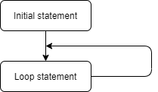
Infinite loop
An infinite loop is a case in which the flow of the program never gets out of the loop.
LECTURE 1
Repeat after me
LECTURE 1
Repeat After Me

Slide 12
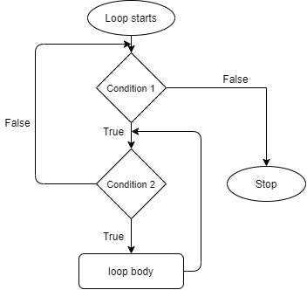
Nested Loops
If there is a looping statement inside of another looping statement, it is known as nested loop
LECTURE 1
Repeat after me
LECTURE 1
Repeat After Me

Slide 13
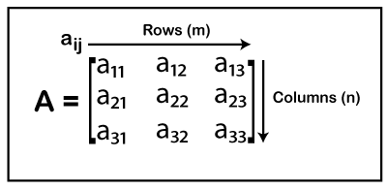
In a 3x3 matrix, for every value of i(row), there are 3 values of j(column)
To iterate through them, you can use a nested loop
LECTURE 1
Repeat after me
LECTURE 1
Repeat After Me

Slide 14
While Loop
The while loop repeats a group of statements while the given condition is True
while (expression) //statement;
Here, the evaluation of controlling expression takes place before the execution of statement in the body.
LECTURE 1
Repeat after me
LECTURE 1
Repeat After Me

Slide 15
Do While loop
Do while is a loop statement in which the evaluation of the controlling expression takes place after the execution of the loop body.
do
{ //statement;
} while (expression);
LECTURE 1
Repeat after me
LECTURE 1
Repeat After Me

Slide 16
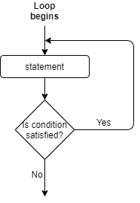
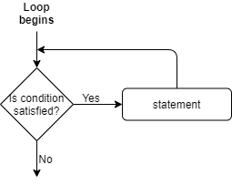
while vs do while
LECTURE 1
Repeat after me
LECTURE 1
Repeat After Me

Slide 17
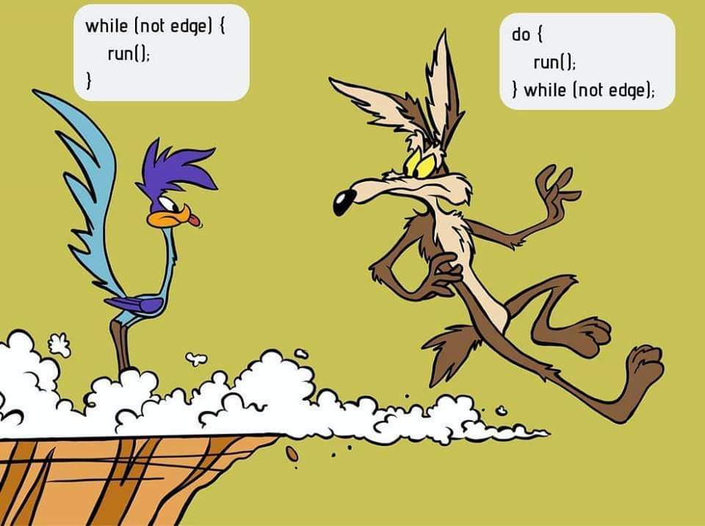
LECTURE 1
Repeat After Me

Slide 18
For Loop
for (initial statement; test expression; update expression) //statement
The evaluation of the test expression is done before the loop while the update expression is executed after the loop
LECTURE 1
Repeat after me
LECTURE 1
Repeat After Me

Slide 19
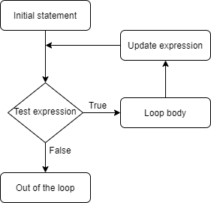
The expression is updated after the execution of the body of the loop
for (int i = 0; i < 5;) { //statement i++; }
LECTURE 1
Repeat after me
LECTURE 1
Repeat After Me

Slide 20
Control Statements
As the name suggests, control statements allows us to control the flow of the execution of the loop.
The control statements in C are:
break
continue
goto
LECTURE 1
Repeat after me
LECTURE 1
Repeat After Me

Slide 21
break statement
It terminates the loop statement or switch statement and executes to the statement after the loop statement.
Basically, it skips the loop statement.
while (expression) { if (condition) break; }
LECTURE 1
Repeat after me
LECTURE 1
Repeat After Me

Slide 22
continue statement
This statement causes a jump to the end of the loop body.
It skips the present iteration of the iteration statement.
while (expression) { if (condition) continue; }
LECTURE 1
Repeat after me
LECTURE 1
Repeat After Me

Slide 23
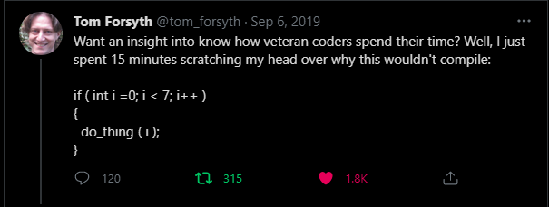
Final thoughts: Don’t worry
LECTURE 1
Repeat After Me

